Slide 1
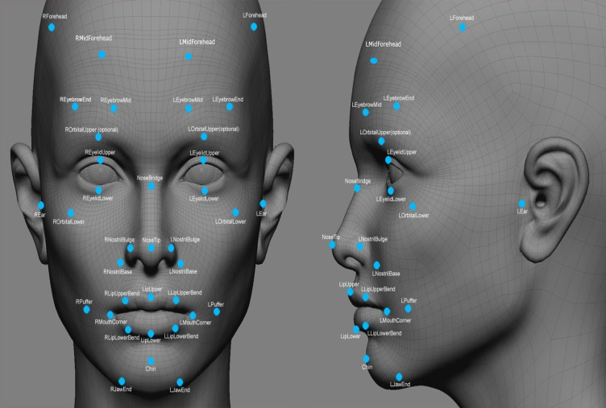
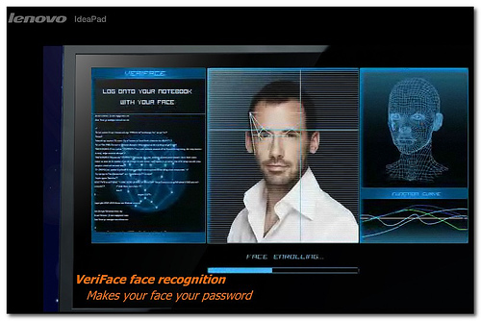
Partial Face Recognition Using Core Feature of face
Project Guide :Krishnendu.S.Nair
Group Members
Priyesh Patil
Jayesh Patil
Kartik Pillai

Slide 2
Contents
Introduction
Problem Definition
Scope of the Project
Literature Survey
Existing System
Proposed System
Hardware requirements
Software requirements
Applications
Summary
References

Slide 3
Introduction
Humans have been using physical characteristics such as face, voice, gait, etc. to recognize each other for thousands of years.
With new advances in technology, biometrics has become an emerging technology for recognizing individuals using their biological traits.
Now, biometrics is becoming part of day to day life, where in a person is recognized by his/her personal biological characteristics.

Slide 4
Introduction
Humans have been using physical characteristics such as face, voice, gait, etc. to recognize each other for thousands of years.
With new advances in technology, biometrics has become an emerging technology for recognizing individuals using their biological traits.
Now, biometrics is becoming part of day to day life, where in a person is recognized by his/her personal biological characteristics.

Slide 5
Examples of different Biometric systems include Fingerprint recognition, Face recognition, Iris recognition, Retina reco- gnition, Hand geometry, recognition, Signature recognition, among others.
Face recognition, in particular has received a considerable attention in recent years both from the industry and the research community. The objective of our project is to create a C# code that can be used to identify people using their face images.
Using the face recognition technique we use in the attendance management system. With the help of the face recognition we make the attendance of the student.

Slide 6
Problem Statement
Every time a lecture, section starts the lecturer or teaching .This is a lengthy process and takes a lot of time and effort, especially if it is a lecture with a huge number of students.
It also causes a lot of disturbance and interruption when an exam is held. Moreover the attendance sheet is subjected to damage and loss while being passed on between different students or teaching staff And when the number of students enrolled in a certain course is huge, the doctors tend to call a couple of student names at random which is not a fair student evaluation process either.

Slide 7
Finally, these attendance records are used by the staff to monitor the students’ 3 attendance rates. This process could be easy and effective with a small number of students but on the other hand, dealing with the records of a large number of students often leads to human errors.

Slide 8
Scope of the Project
The proposed face recognition system works with limitations, and it does not work effectively when it finds high variation in pose and when database is large. Further research can be carried out to design a low resolution face recognition which works efficiently for large database and for face databases with high variation in pose. ANN grouping can be used to overcome the problem of face recognition with large data base and SVM classifiers can be used to improve the face reco-gnition rate with high variation in pose.

Slide 9
Literature Survey
Biometrics is the automated recognition of individuals based on their behavioural or physiological characteristics .The physiological characteristics are related to the shape of the body.
The most common example is fingerprint. Other examples include face recognition, hand geometry and iris recognition. The behavioural characteristics are related to the behaviour of a person.
Signature is one example of these characteristics which is still widely used today. Modern approaches are the study of keystroke dynamics and voice.

Slide 10
With the rapid development in the field of pattern recognition and its uses in different areas e.g. (signature recognition, facial recognition), arises the importance of the utilization of this technology in different areas in large organizations.
This research is the first of its kind to attempt to provide an automated attendance system that recognizes students using face recognition technology through an image/video stream to record their attendance in lectures or sections and evaluating their performance accordingly.
Face recognition is a biometric which uses computer software to determine the identity of the individual. Face recognition falls into the category of biometrics which is “the automatic recognition of a person using distinguishing traits” Other types of biometrics include fingerprinting, retina scans, and iris scan.

Slide 11
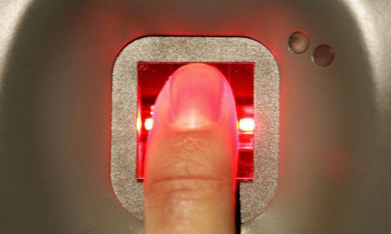
Existing System
Finger print attendance system :- This is a system in which a persons finger print is detected by a laser and the attendance is marked.

Slide 12
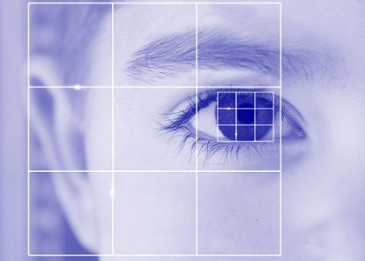
Retina scan :- Retina of a eye is scaned individually by a scanner and attendance is marked.

Slide 13
Proposed System
Face Recognition Process:-
Acquiring a sample: In a complete, full implemented biometric system, a sensor takes an observation. The sensor might be a camera and the observation is a snapshot picture. In our system, a sensor will be ignored, and a 2D face picture “observation” will supplied manually
Acquiring a Sample
Extracting Features
Comparison Templates
Declaring a Match

